Slide 1
CCEDIR Reflection MATH140B, Dr. Steward
Aurora Colter

Slide 2
Agenda
Goals
Tool Reflections
Course Observations
Final Conclusions & Takeaways

Slide 3
Pre-Observation Goals
Wait time after question
Activity Percentage Breakdown
Content Questions vs Fishing
Notes:
Highlight the codes that were important for this (content question versus general question)

Slide 4
Tool Observations
Pros:
Easy to use
CSV easy to work with
Easy distribution
Comment Feature
Cons:
Observation Edits/ Mistakes
No end course timestamp in CSV
No follow up question observation

Slide 5
Course Observations
Wait time after question
Manual Timing: 9.76 seconds
CCEDIR Timing: 10.88 seconds (including asking time)
Activity Percentage Breakdown
Approximately 50-50 instructor-student breakdown
Groupwork highest Percentage, then Lecture
Content Questions vs Fishing
Approximately 7.2% of questions were fishing questions

Slide 6
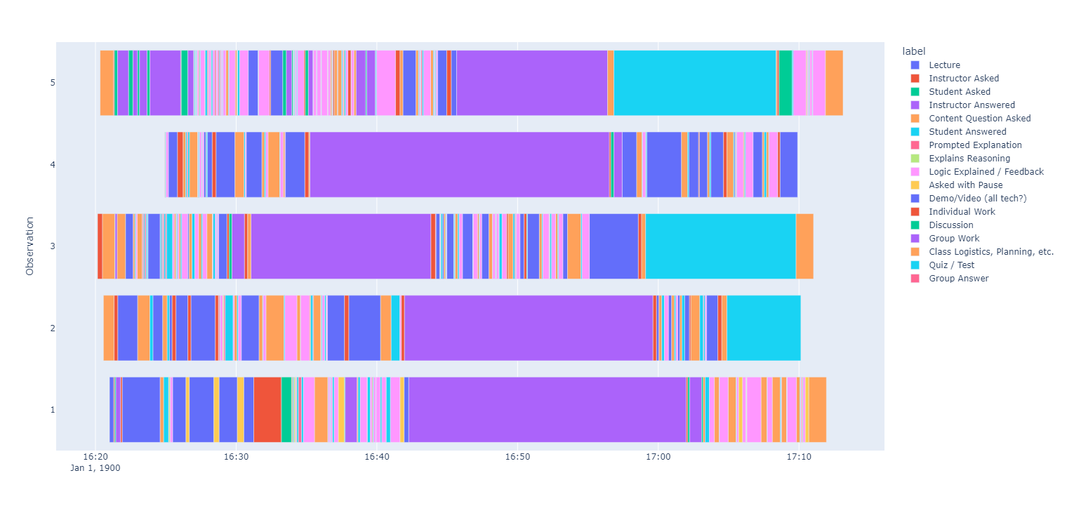

Slide 7
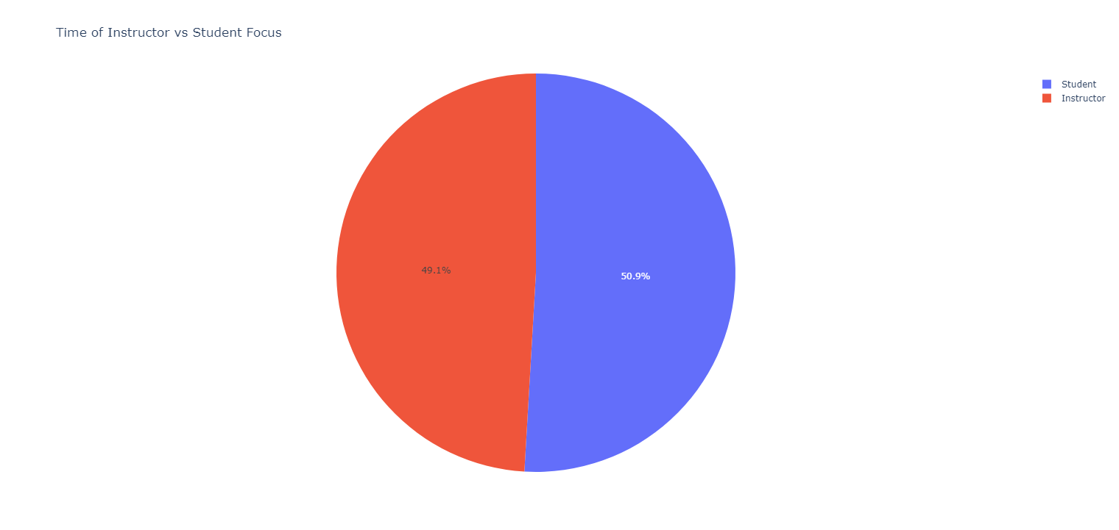

Slide 8
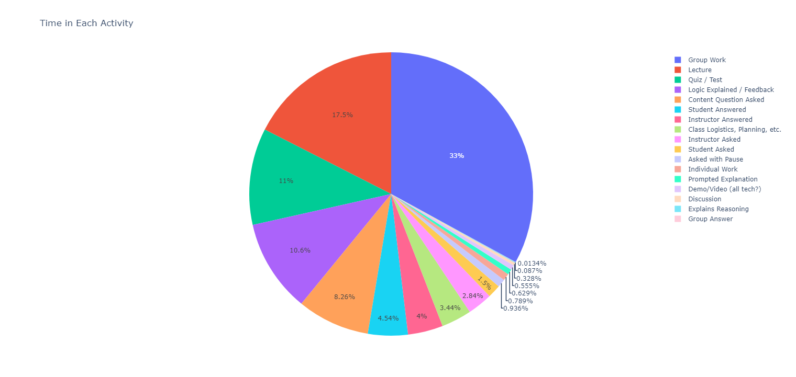

Slide 9
Post-Observation Conclusions
Percentage Breakdown Goals
Appropriate Wait Time Lengths
Follow-up Questions

Slide 10
Final Observation Takeaways
Notes:
What would you code differently, How did you benefit from observations

Slide 11
Thank you

